Slide 1
SDK Road Mapping
Building a Developer Portal

Slide 2
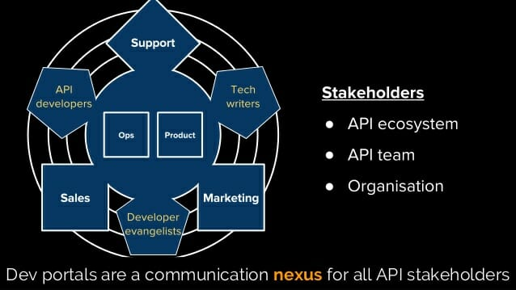
https://nordicapis.com/how-bad-developer-portals-kill-apis/

Slide 3
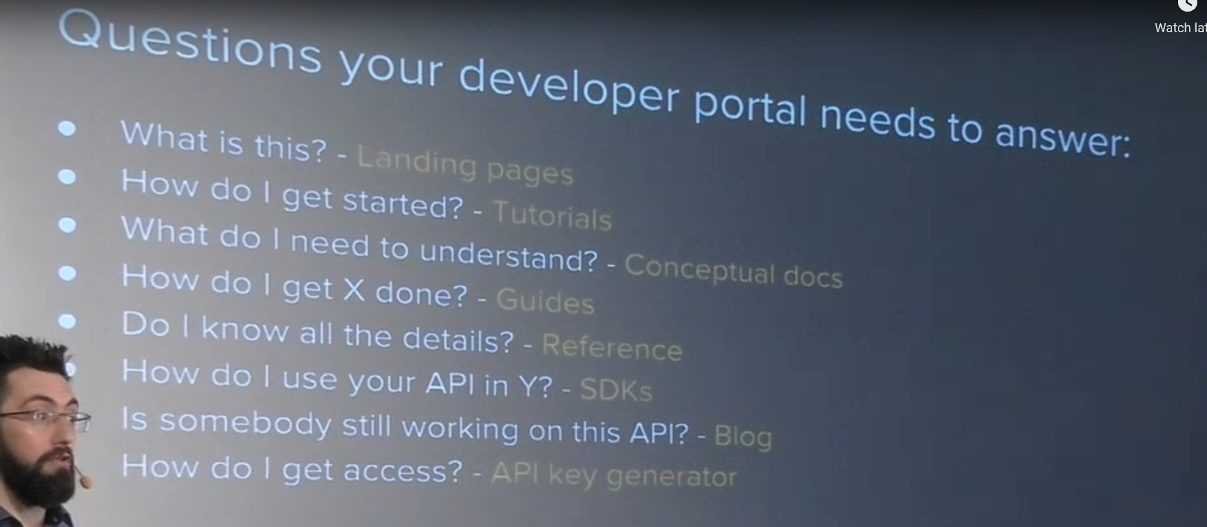

Slide 4
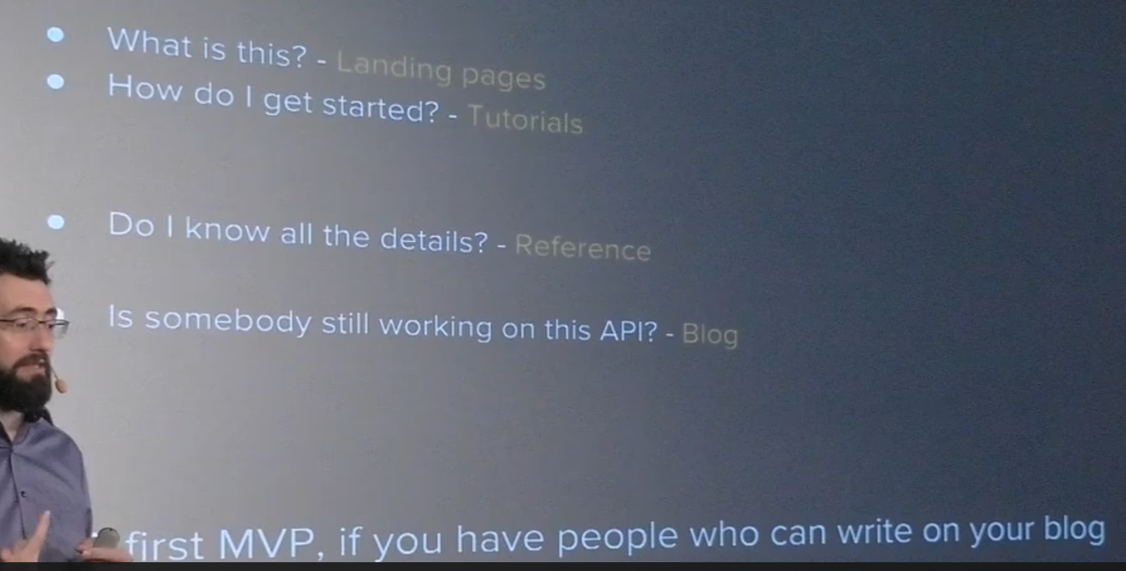
Minimum Viable Product

Slide 5
